Slide 1
311 Complaints
William Wang

Slide 2
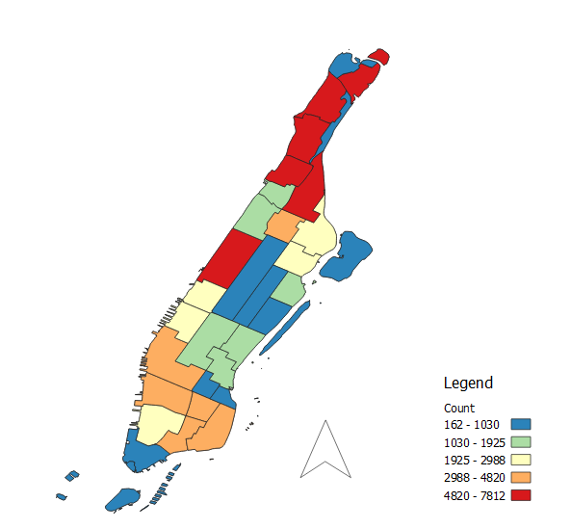
311 Noise Complaints by Graduated Map
Spectral Colors to accentuate the data
Quantile Representation
Highest number of complaints in upper and Lower Manhattan

Slide 3
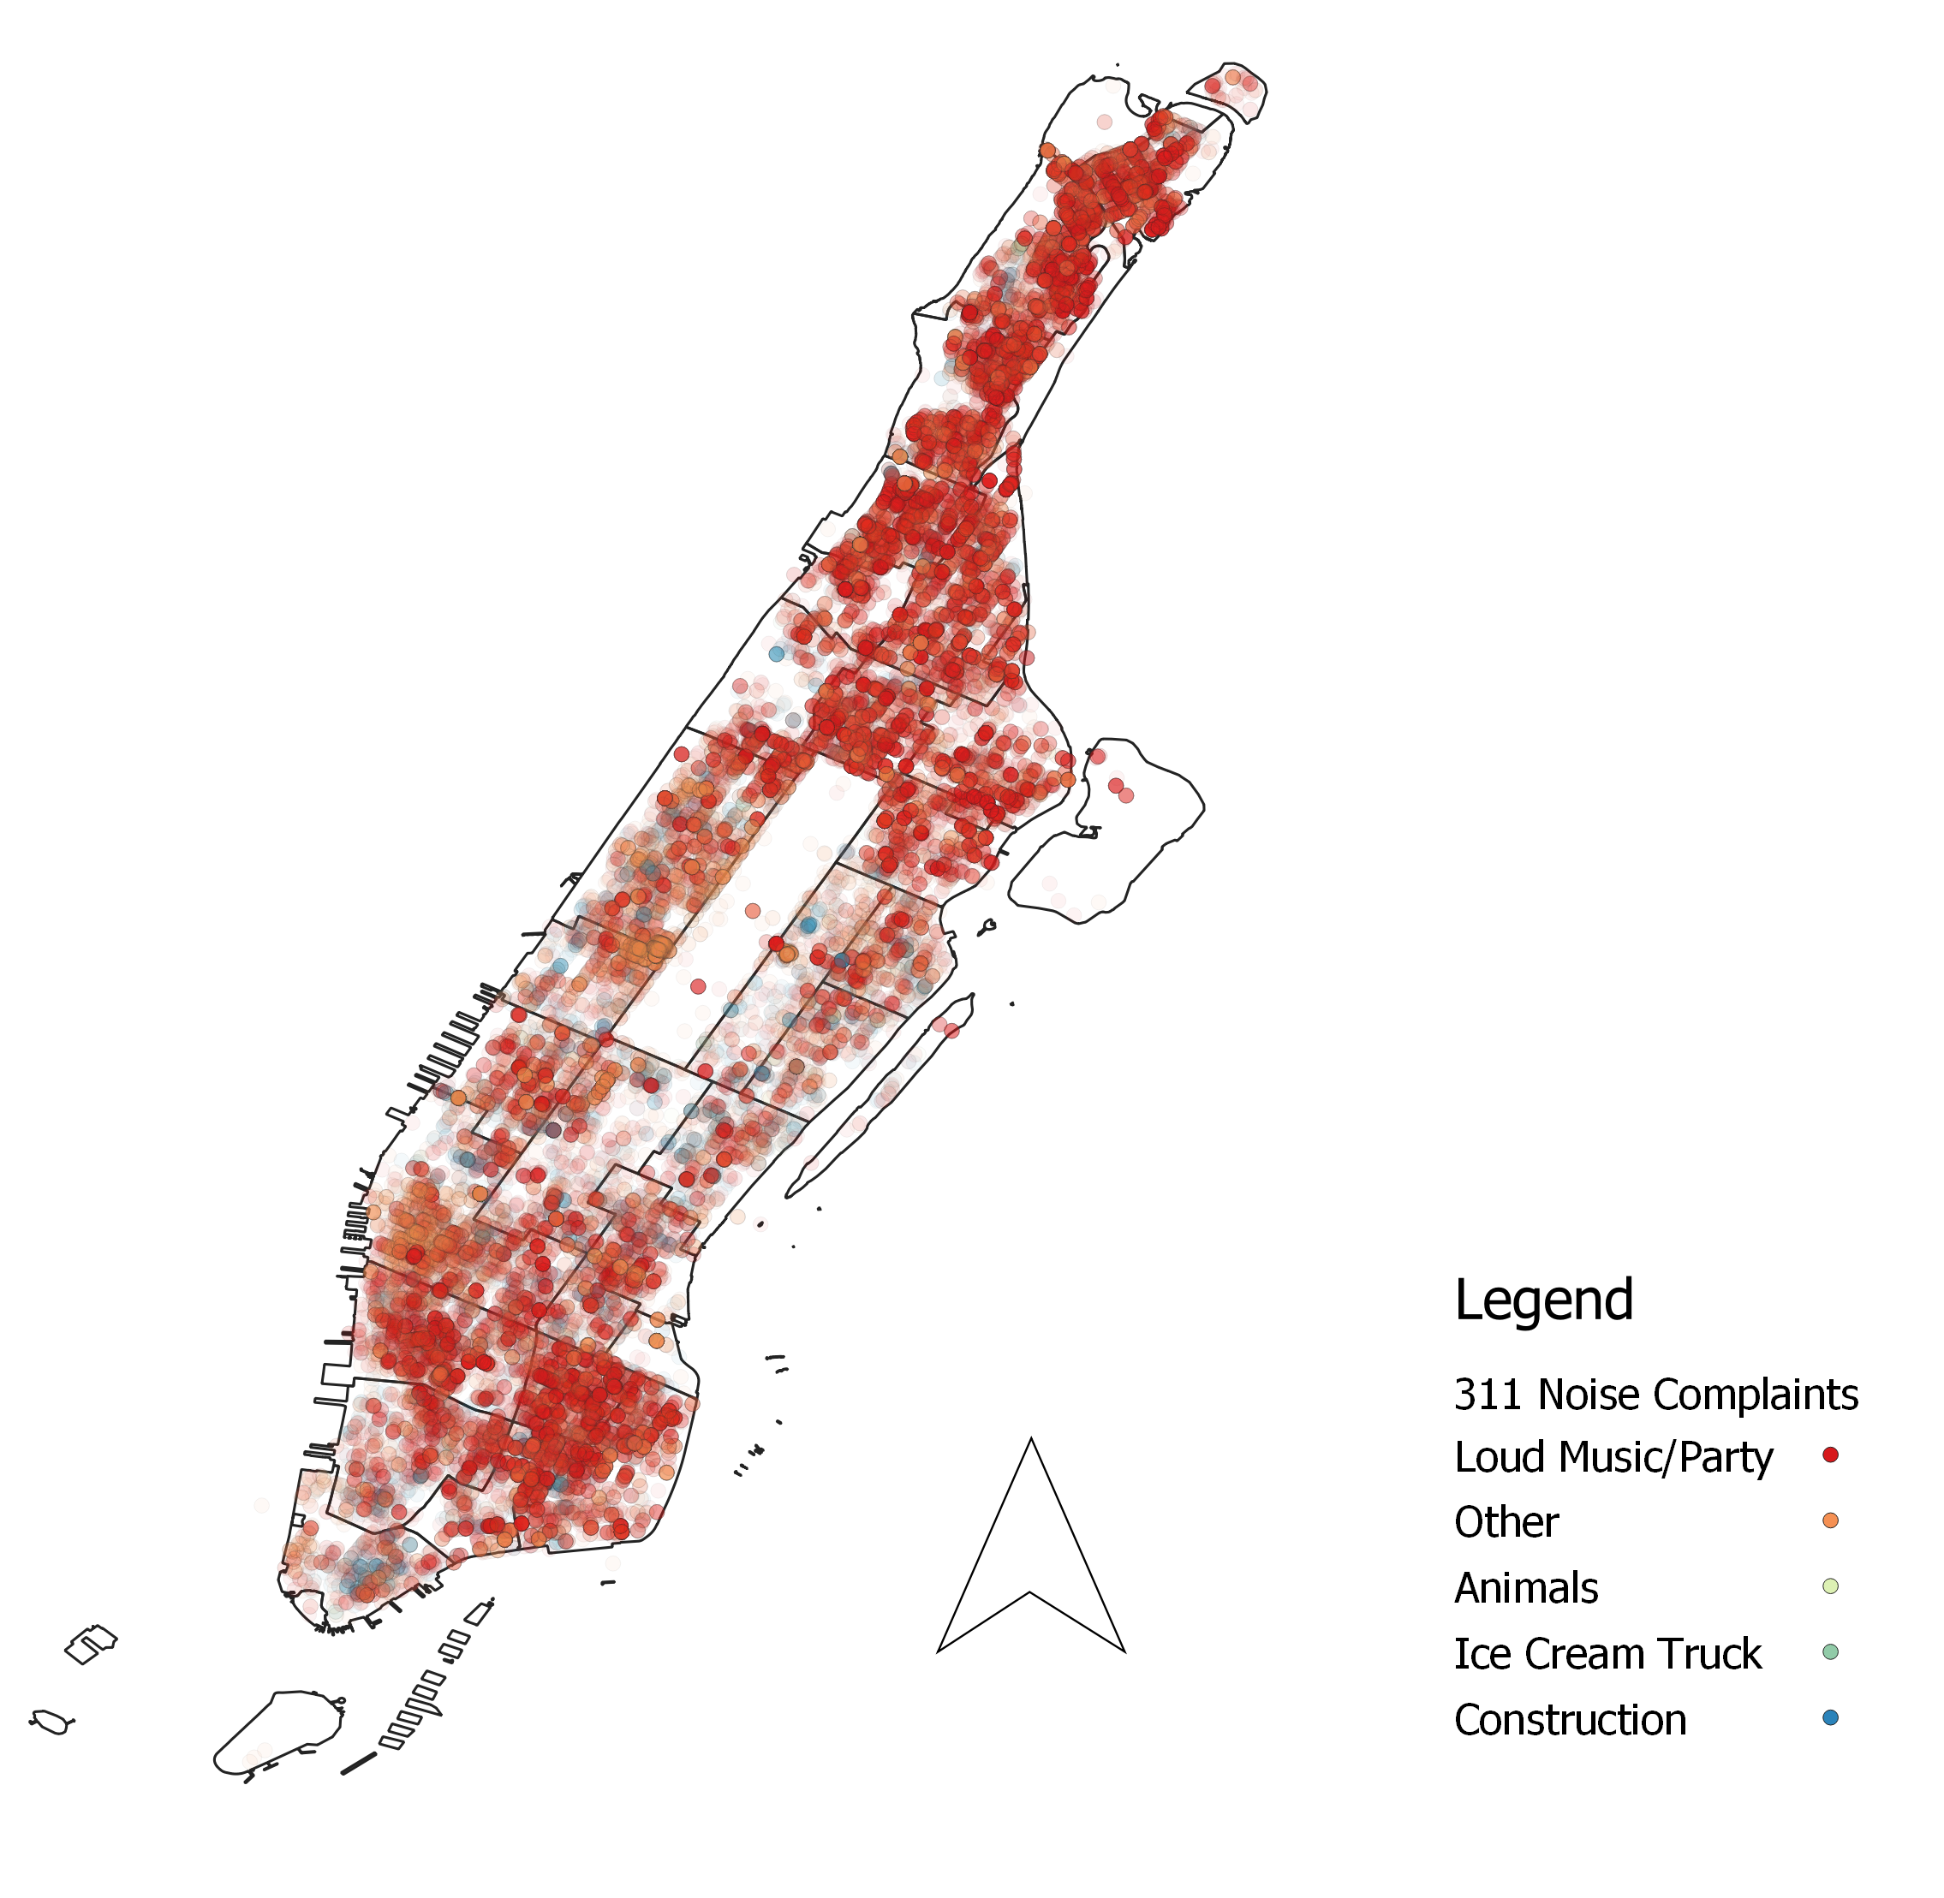
311 Complaints by Point Representation
Divided into descriptions
Opacity to show the frequency of an event happening

Slide 4
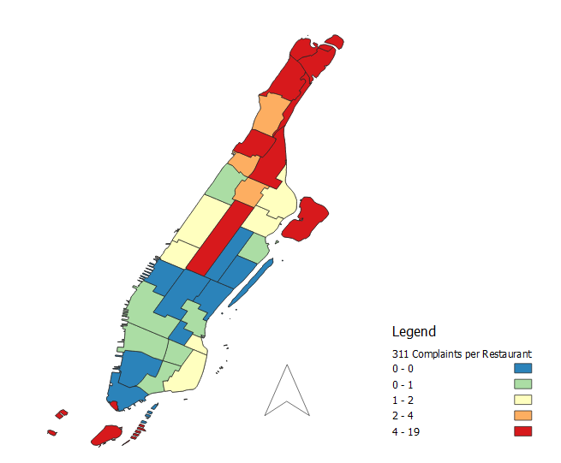
311 Complaints per Restaurant
Restaurants represent higher foot traffic and more spending.
0 represents more Restaurants than complaints
Highest number of complaints in upper Manhattan

